Slide 1
How to Read a Scientific Article
Tips and Suggestions
Page Van Meter, PhD
Department of Zoology
Michigan State University

Slide 2
Journal
Name recognition
Science
Nature
Applied Clay Science
Impact factor
Science 28.103
Nature 31.434
Applied Clay Science 2.005
Notes:
Impact factor is based on the number of times that journals articles were cited

Slide 3
Finding Articles
Google
Your local librarian
Your friend who still has access to an institutional license
Pubmed

Slide 4
Finding Articles
Google
Your local librarian
Your friend who still has access to an institutional liscence
Pubmed

Slide 5
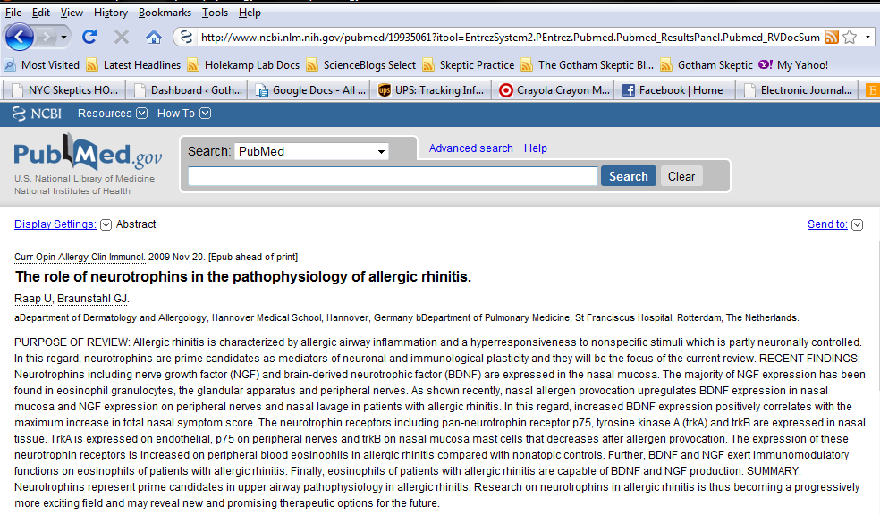
Finding Articles
Google
Your local librarian
Your friend who still has access to an institutional liscence
Pubmed

Slide 6
Author Order

Slide 7
Author Order

Slide 8
The Pieces
Abstract
Introduction
Methods & Results
Discussion
References

Slide 9
Abstract
SHOULD YOU READ THE WHOLE PAPER?
Mini paper
Background 1-2 sentences
Methods 1-2 sentences
Results 2-3 sentences, rarely stats
Conclusion 1 sentence
Ramifications 1 sentence
Over simplified, uninformative for facts

Slide 10
Introduction
Provides context and background
Sets up aim and goals
What to look for:
Identify the claim/primary argument
Asses evidence/background
Establish vocabulary and acronyms
D.A.F.T. - Dust and Aerosol Measurement Feasibility Test
S.N.O.T – Sino-Nasal Outcome Test

Slide 11
Methods and Results
Don’t get bogged down in the details
Read them one at a time
Reread them together

Slide 12
Discussion
Do the concluding statements adequately reflect the results of the study?
Red flags-Authors spend a lot of time:
Explaining why they didn’t find what they expected
Focusing on a result that was not the original intent of the study
Conclusions don’t quite match the abstract

Slide 13
References
Leads to prior papers from that group
And on that topic
BUT!
Should cite others’ research thoroughly!

Slide 14
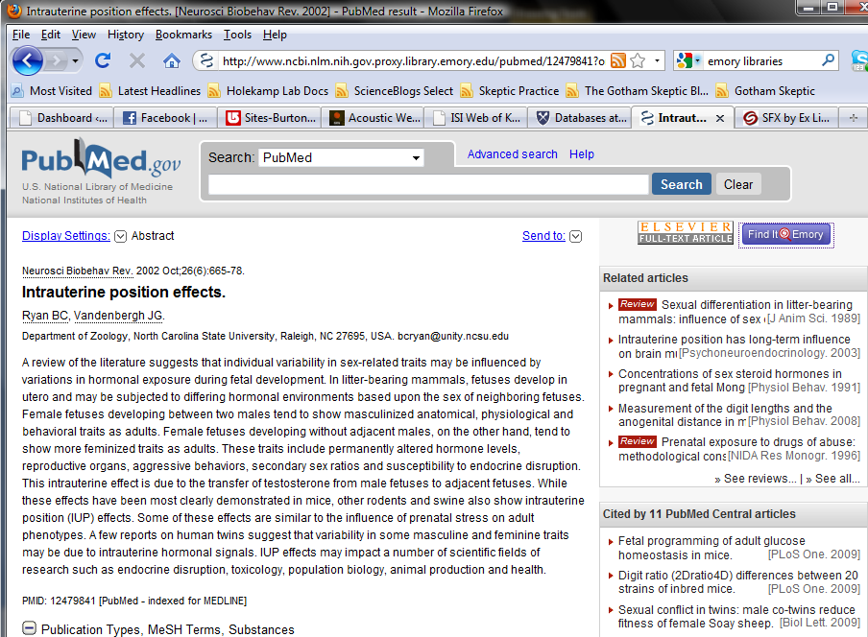
Cited By:

Slide 15
Gerbil Article
Intrauterine position
Ratio of male and female fetuses affects development
2F females
2M females
Enjoy!

