Slide 1
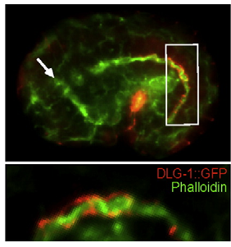
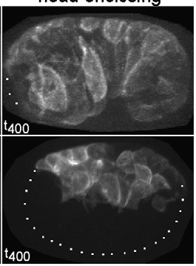
Importance of double-blinding in basic research: why does none of our data match?
Skepticamp 2010
Yelena (Ellen) Bernadskaya

Slide 2
Topics of the day:
Applied VS basic research.
Overview of experimental design.
Academic VS clinical research.
Aspects of academic studies VS RCT studies.
Implications for basic research.

Slide 3
Basic VS Applied Research
Basic
Applied
Carried out for
general knowledge
Carried out to solve
a specific problem
Exploratory
Conducted mostly
by industries
Conducted mostly by
universities
LOTS of grey areas and crosstalk!

Slide 4
The Scientific Method Revisited
Ask a question
Experimental design
Sample size – as many as possible!
Accuracy of measurement – standard error measurement.
Statistical significance – different statistical tests with a 95% confidence interval
Replication of results by others
Do background
research
Try again
Construct
hypothesis
Test hypothesis
Analyze results
Results support
hypothesis
Results do not
support hypothesis
Report results

Slide 5
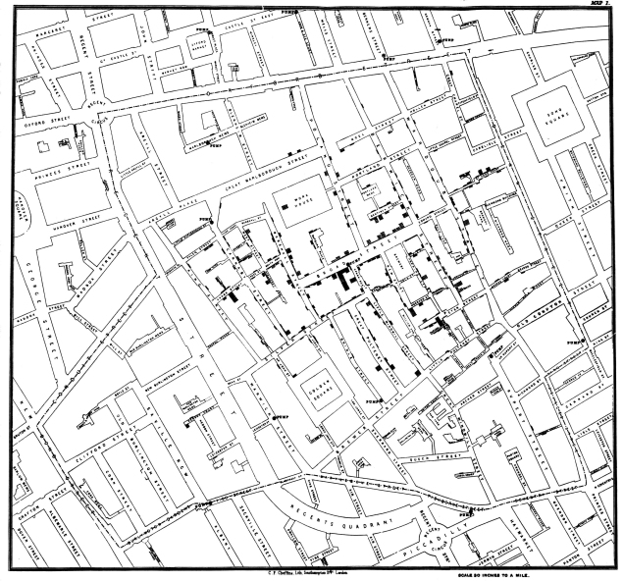
What kinds of test can we design?
Controlled experiments
Drug trials, lab experiments
Will often have a negative and
a positive control.
Observational experiments
Used in economics,
epidemiology, ecology.
Famous example –
the Snow Cholera map
of 1854 would be considered
an observational experiment.

Slide 6
Academic VS Clinical Research
Academic research
Can be funded by NSF and NIH
In some cases not research is not obviously connected to health research.
Most of the time uses simpler animal or in scilico models.
Short term and can include drug discovery.
Clinical trials
Mostly receive NIH funding
Often done for health related products before market release.
Trials progress through phases before product comes to market.
Are often long-term.

Slide 7
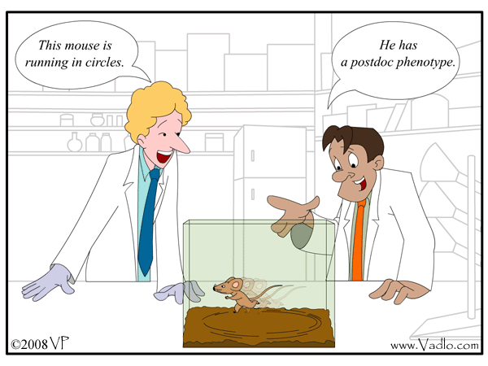
Features of academic studies
Defining the question
May be difficult to focus on a single topic.
Generation of reagents
Reagents often need to be generated from scratch.
No blinding
Experimenter always knows what sample he is looking at.
Analysis
Analytical methods vary, often have to establish new analytical techniques.
Greatly depend on the equipment available.
In some cases, lack of statistical analysis or very basic analysis such as Standard Deviation.

Slide 8
Problems of academic research.
Very difficult to eliminate personal bias.
Particularly in biological sciences, statistical analysis is lacking.
In some cases very difficult to get large sample sizes.
Reproducibility varies.
Pressure to publish can result in poorly tested data being used.

Slide 9
Features of the RCT and can they be applied to academic research?
Randomization – divisions of participants into groups
Facilitates blinding
Reduces bias
Consideration of confounding factors
Blinding
Single blind – information is withheld from participants to prevent bias.
Double blind – information is withheld from both the participants and researchers.
Analysis
Different forms of statistical analysis depending on the experimental parameters.

Slide 10
What this means for our research.
Results of an experiment are going to be inherently biased depending on the hypothesis being tested.
Data may be manipulated to support a favorable hypothesis or negate a contradicting hypothesis
We are going to be WRONG… A LOT!
But it’s not all bad news

Slide 11
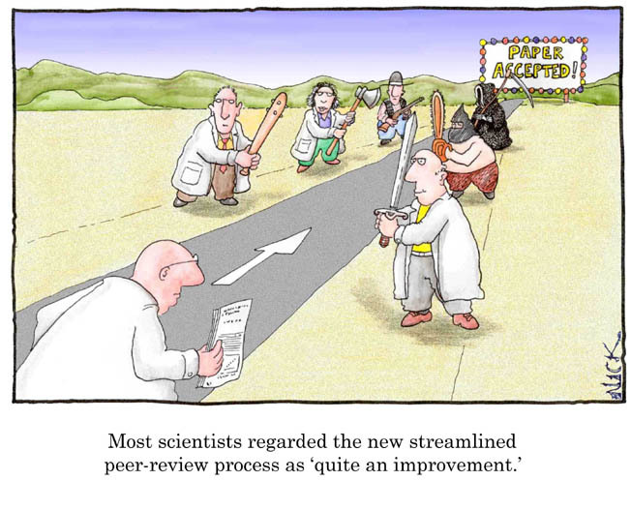
The strength of science
Competition between labs
Creates a self-correcting mechanism
Steps can be taken to limit bias:
General
Include a statistics course in the graduate curriculum.
Individual
Blind ourselves – either have someone code the samples so that they cannot be readily recognized or have a person with no vested interest repeat your analysis.
Have a minimum sample size.

Slide 12
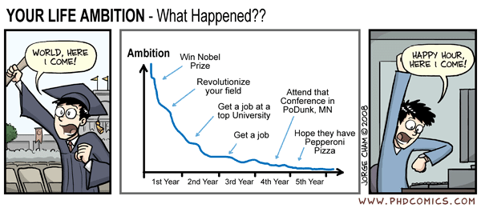
Thanks and enjoy SkeptiCamp!!
Images are taken from:
Patel FB, Bernadskaya YY, Chen E, Jobanputra A, Pooladi Z, Freeman KL, Gally C, Mohler WA, Soto MC.
The WAVE/SCAR complex promotes polarized cell movements and actin enrichment in epithelia during C. elegans embryogenesis. Dev Biol. 2008 Dec 15;324(2):297-309. Epub 2008 Oct 2.

