Slide 1
Dental Amalgam: Is It Safe?
Skepticamp
NYC Skeptics Society
December 4, 2010
Spiro Condos, DDS
Clinical Associate Professor
New York University College of Dentistry
Private Practice, New York, NY

Slide 2
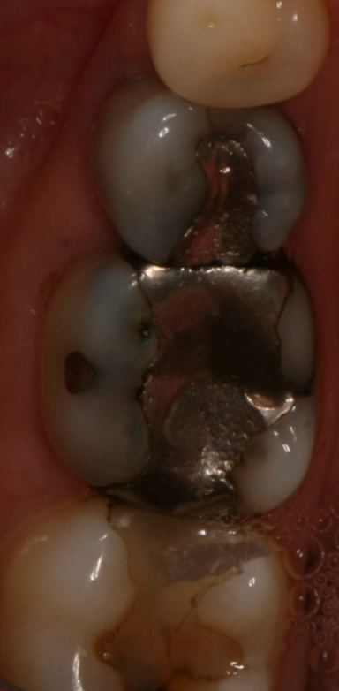
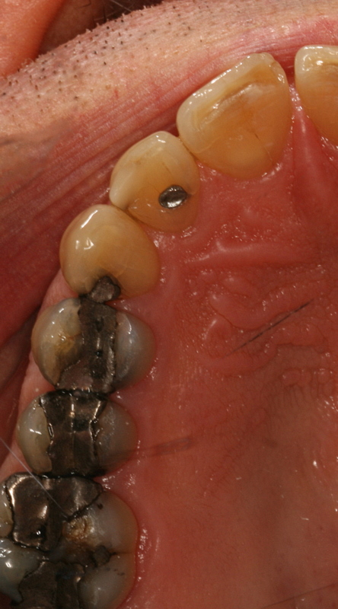
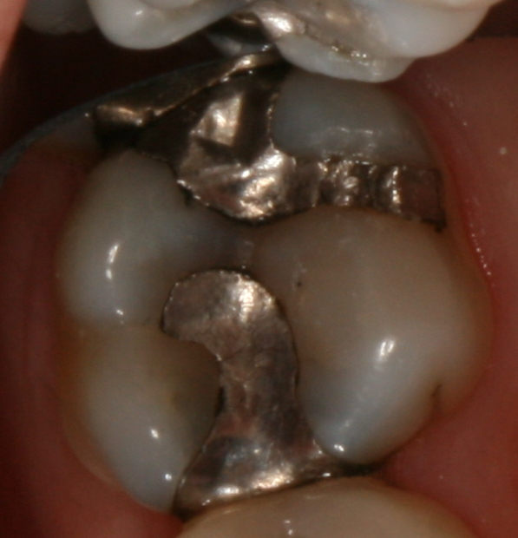

What is Amalgam?

Slide 3
History of Amalgam
Tin mercury amalgams used in China in 600 AD
Silver mercury fillings invented in France in 1830s
1850s amalgam using dentists sued by non amalgam using dentists in US - started “amalgam wars”
1896 GV Black advocated amalgam use in detailed scientific paper, but it took many years to be accepted

Slide 4
Early amalgam made by heating tablet in a spoon until beads of mercury appeared, then mixing in a mortar and pestle
1930 commission found modern method of amalgam fabrication safe
Current formulation made up of approx. 50% mercury, 50% Silver, Copper, Zinc and Tin in various proportions
Solid metals make up an alloy; when mixed with mercury, they form an amalgam

Slide 5
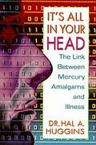
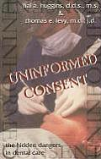

Where did the controversy begin?
Hal Huggins, DDS
1970s, Hal Huggins, DDS circulates belief that mercury causes wide range of maladies, including neurological, cardiovascular, immunological, collagen, emotional and allergic diseases and in 1985 publishes book “It’s All in Your Head: Diseases caused by silver-mercury restorations” Solona Beach, Ca.: APW alleging dangers of mercury toxicity

Slide 6
Supposed Effects of Amalgam Toxicity
Neurological, Cardiovascular, Immunological, Collagen, Emotional and Allergic syndromes
Leading to: Multiple Sclerosis, Depression, High or Low blood pressure, tachycardia, arthritis, lupus, scleroderma, leukemia, Hodgkin’s disease, mononucleosis, fatigue, Crohn’s disease, ulcers, other digestive problems and high cholesterol
Huggins is currently also applying his treatments to soldiers with “Gulf War Syndrome” and claims to be hampered by the government

Slide 7
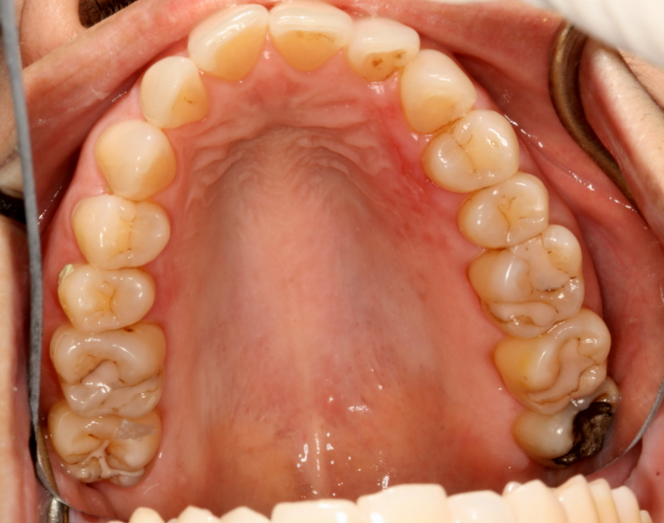
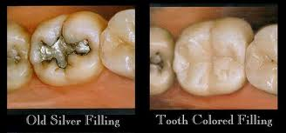
Supposed Effects of Amalgam Toxicity
Huggins found other materials in amalgam toxic: Zinc, Copper, Nickel, and several compounds in composite fillings
Measured electric current in fillings, determined fillings had to be removed in correct order for treatment to be most effective, if not harmful
Found root canals also responsible for various maladies – primary etiologies in sinus inflammation and high blood pressure

Slide 8
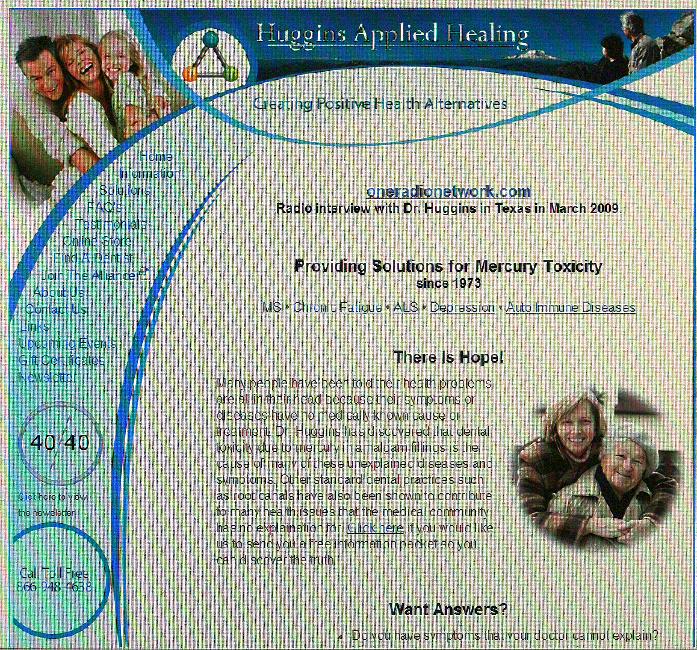
He found that there was always a strong psychological component associated with autoimmune diseases; that there were chemistry imbalances that turned out to be “fingerprints” of diseases; that acupressure was important in neurological diseases; that family support or lack of it often governed whether or not a patient recovered.
Worried that his work would be rejected for lack of controls
Claims conspiracy by ADA, and feels ADA is liable for 82 quintillion dollars
Lost his license, and formed holistic dentist referral network through his website; Huggins Applied Healing
Source: “Huggins’ Story” pdf found at http://www.enterhisrest.org/articles/dr_huggins_story.pdf

Slide 9
What are possible reasons for different results in amalgam studies?
placebo effects of treatment; –
statistical regression toward the mean; –
spontaneous remission; –
natural variability of signs and symptoms; –
failure to consider treatment dropout; –
bias in self-reports of symptom remission.

Slide 10
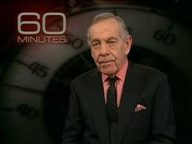
Is there Poison in your Mouth?
Mercury from dental "silver" tooth fillings impairs sheep kidney function
N. D. Boyd, H. Benediktsson, M. J. Vimy, D. E. Hooper and F. L. Lorscheider
Department of Pathology, Faculty of Medicine, University of Calgary, Alberta, Cana
60 Minutes Dec 16, 1990

Slide 11
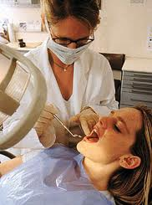
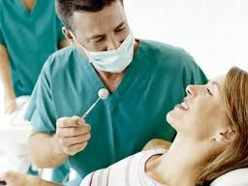
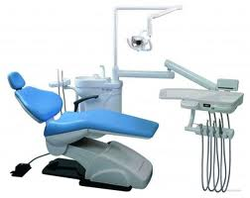
What does the rest of the profession think?
8.7% of dentists in 1995 study wanted to ban amalgam, 14.3% unsure about it’s use
    Product Use Survey, 1995. Clin Res Associates Newsletter. 1995;19(10):4.

Slide 12

A Skeptical Response
The amalgam controversy; An evidence-based analysis
JOHN E. DODES, D.D.S.
J Am Dent Assoc, Vol 132, No 3, 348-356.
© 2001 American Dental Association

Slide 13
What is Mercury?
Normal component of environment, between 2,700 and 6,000 tons of mercury released annually from earth’s crust and oceans
Another 2,000-3,000 tons released due to human activity, primarily burning household and industrial waste and coal.
  Foulke JE. Mercury in fish: cause for concern? FDA Consumer 1994;Sept:6–9.
1969 toxicology report classified mercuric compounds in order of decreasing toxicity: methyl and ethylmercury>mercury vapor>inorganic and organic salts
  Berlin MH, Clarkson TW, Friberg LT, et al. Maximum allowable concentrations of mercury compounds: report of an international committee. Arch Environ Health 1969;19:891–905.

Slide 14
Why is mercury so bad?
Exact mechanism of toxicity not fully understood, probably due to affinity for sulfydryl groups on proteins, but poor correlation of invivo and invitro studies makes conclusions difficult to make
    Newman S. Mercury toxicity. In: Workshop on Biocompatibility of Metals in Dentistry, Chicago, July 11–13, 1984. Chicago: American Dental Association; 1984:96–8.

Slide 15
How much mercury are we talking about?
Mercury is released into mouth due to corrosion, an oxidation-reduction reaction due to an interaction between metals in amalgam and non-metallic elements
    von Fraunhofer JA, Staheli PJ. Corrosion of dental amalgam. Nature 1972;240(5379):304–6
Daily mercury release and absorption rate estimates range from 10mcg/cubic meter/day…….
    Svare CW, Peterson LC, Reinhardt JW, et al. The effect of dental amalgams on mercury in expired air. J Dent Res 1981;60(9):1668–71. Abraham JE, Svare CW, Frank CW. The effect of dental amalgam restorations on blood mercury levels. J Dent Res 1984;63(1):71–3. Vimy MJ, Lorscheider FL. Intra-oral air mercury released from dental amalgam. J Dent Res 1985;64(8):1069–71. Vimy MJ, Lorscheider FL. Serial measurements of intra-oral air mercury: estimation of daily dose from dental amalgam. J Dent Res 1985;64(8):1072–5. Vimy MJ, Lorscheider FL. Dental amalgam mercury daily dose estimated from intra-oral vapor measurements: a predictor of mercury accumulation in human tissues. J Trace Elem Exp Med 1990;3:111–23. Hahn LJ, Kloiber R, Vimy MJ, Takahashi Y, Lorscheider FL. Dental ‘silver’ tooth restorations: a source of mercury exposure revealed by whole-body image scan and tissue analysis. FASEB J 1989;3(14): 2641–6
To 1-2 mcg/day…..
    Olsson S, Bergman M. Letter to the editor. J Dent Res 1985;66: 1289. Mackert JR Jr. Factors affecting estimation of dental amalgam mercury exposure from measurements of mercury vapor levels in intra-oral and expired air. J Dent Res 1987;66(12):1775–80.
    Berglund A, Pohl L, Olsson S, Bergman M. Determination of the rate of release of intra-oral mercury vapor from amalgam. J Dent Res 1988;67(9):1235–42.
    Olsson S, Berglund A, Pohl L, Bergman M. Model of mercury vapor transport from amalgam restorations in the oral cavity. J Dent Res 1989;68(3):504–8.
    Langworth S, Kohlbeck KG, Akesson A. Mercury exposure from dental restorations, II: release and absorption. Swed Dent J 1988; 12(1–2):71–2
References from:
Dodes, J
J Am Dent Assoc, Vol 132, No 3, 348-356.
© 2001 American Dental Association

Slide 16
How do we know what’s too much?
Lowest observed adverse effect level (LOAEL)
No observed adverse effect level (NOAEL)
  LOAEL is
    100 mcg/cubic meter for clinicalmercurism,
    50 mcg/cubic meter for nephrotoxicity
  NOAEL (WHO) is 25 for industrial threshold
  5 for general public
  1 for children, pregnant women and ill people.
    Gerstner HB, Huff JE. Clinical toxicology of mercury. J Toxicol Environ Health 1977;2(3):491–526
    Gerstner HB, Huff JE. Selected case histories and epidemiologic examples of human mercury poisoning. Clin Toxicol 1977;11(2):131–50.

Slide 17
How much is too much?
Clinically significant effects (erethemism, intention tremor, gingivitis) not seen below 100mcg/cubic meter
    U.S. Department of Health and Human Services. Committee to Coordinate Environmental Health and Related Programs. Subcommittee on Risk Management. Dental amalgam: A scientific review and recommended Public Health Service strategy for research, education and regulation—Final report of the Subcommittee on Risk Management of the Committee to Coordinate Environmental Health and Related Programs, Public Health Service. Washington: Department of Health and Human Services; 1993:Appendix III:1. DHHS publication 96–0445.

Slide 18
What’s safe?
NOAEL – children 1mcg/cubic meter x 22cubic meter/day respiration rate = 20mcg/day threshold level for lungs
NOAEL - x 10 for low absorption rate, x 2 for greater safety of mercury compounds compared to elemental mercury = 400mcg/day for gastro-intestinal tract.
    Eley BM. The future of dental amalgam: a review of the literature, Part 4—mercury exposure hazards and risk assessment. Br Dent J 1997;182(10):373–81

Slide 19
What’s not safe
In Minamata, Japan, industrial waste released large volumes of mercury into ocean, which was metabolized into methylmecury by bacteria, eaten by fish, and then Japanese people
Death, central nervous system disturbances, and teratogenic effects occurred, known as Minamata Disease
It is estimated that 5mg/day is necessary dose for Minamata disease, an amount 1,000 times higher than dosages we are discussing

Slide 20
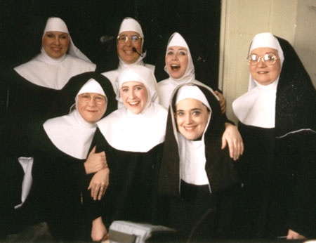
Nunsense!
Nuns, aged between 72 and 102, living together in two convents w/w/out Alzheimer’s compared to each other
Nuns w/w/out amalgams had equivalent scores on eight cognitive tests, and on autopsy.
    Saxe SR, Snowdon DA, Wekstein MW, et al. Dental amalgam and cognitive function in older women: findings from the nun study. JADA 1995;126(11):1495–501

Slide 21
What about us dentists?
Urine tests conducted on dentists at 2 ADA conventions showed higher concentrations of mercury in urine than general public
No greater kidney dysfunction than general populace
    Joselow NM, Ruiz R, Goldwater LJ. Absorption and excretion of mercury in man, XIV: salivary excretion of mercury and its relationship to blood and urine mercury. Arch Environ Health 1968;17(1):35–8.
    Eley BM. The future of dental amalgam: a review of the literature, Part 2—mercury exposure in dental practice. Br Dent J 1997;182(8): 293–7.
    Powell LV, Johnson GH, Yashar M, Bales DJ. Mercury vapor release during insertion and removal of dental amalgam. Oper Dent 1994;19(2):70–4
    Naleway C, Chou HN, Muller T, Dabney J, Roxe D, Siddiqui F. On-site screening for urinary Hg concentrations and correlation with glomerular and renal tubular function. J Public Health Dent 1991; 51(1):12–7.[Medline]

Slide 22
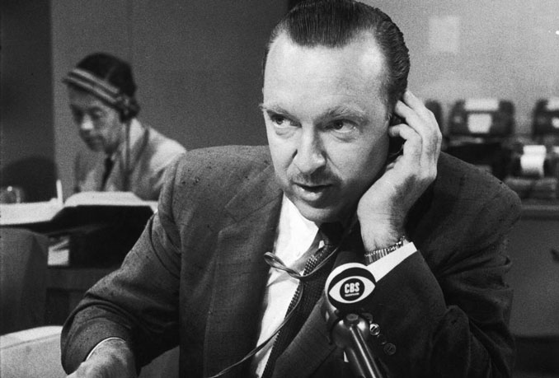
This just in…
JAMA. 2006;295(15)1775-1783
Neuropsychological and Renal Effects of Dental Amalgam in Children
A Randomized Clinical Trial
David C. Belinger, PhD, MSc; Felicia Trachtenberg, PhD, Lars Barregard, MD PhD; Mary Tavares DMD, MPH, et al
534 children in Massachusetts in Harvard study, 6-10 yrs old, half received composite, half amalgam
Evaluated over 5 years, no differences in neuropsychological or renal function
JAMA. 2006;295(15):1784-1792 (doi:10.1001/jama.295.15.1784)
Timothy A. DeRouen; Michael D. Martin; Brian G. Leroux; et al.
A Randomized Clinical Trial
Neurobehavioral Effects of Dental Amalgam in Children:
507 children in Portugal, 8-10 years old, followed for 7 years
Half received amalgam, half received composite
No differences in any neurologic or behavioral parameter, although amalgam children had slightly higher mercury in urine
Composite group had 50% greater need for restorative treatment after 5 years

Slide 23
In conclusion
Amount of mercury necessary to observe any effect in most vulnerable population is 20-400mcg/day and is orders of magnitude lower than amounts needed for actually observed disease
Estimates of mercury release due to amalgam range from 1-10mcg/day, well below levels established by the WHO
Amalgam alarmists use poorly controlled studies whose results have not been replicated by other investigators, and generally make outrageous, unsubstantiated claims
Several controlled, properly performed studies show no correlation between amalgams and any population, from children to the elderly

Slide 24

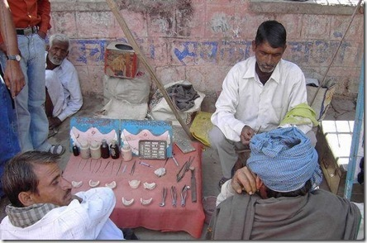

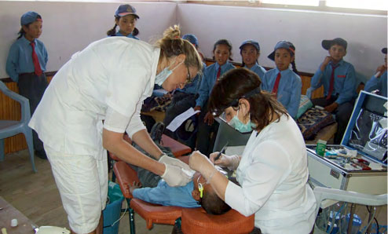
Where’s the harm in not using Amalgam?

Slide 25
Thank you!

Slide 26
In conclusion
Amount of mercury necessary to observe any effect in most vulnerable population is 20-400mcg/day and is orders of magnitude lower than amounts needed for actually observed disease
Estimates of mercury release due to amalgam range from 1-10mcg/day
Several controlled, properly performed studies show no correlation between amalgams and any population

Slide 27
« Headache Could Be Tied To Dental Pain Dental Tourism Call To Travel For Healthy Smile »
Danger Of Dental Amalgam Fillings To Pregnant Women And Children
June 9th, 2008, By Dental Health Magazine Staff

Slide 28
Original Contribution
JAMA. Original Contribution
JAMA. 2006;295(15)1775-1783
Neuropsychological and Renal Effects of Dental Amalgam in Children
A Randomized Clinical Trial
David C. Belinger, PhD, MSc; Felicia Trachtenberg, PhD, Lars Barregard, MD PhD; Mary Tavares DMD, MPH, et al
534 children, 6-10 yrs old, half received composite, half amalgam
Evaluated over 5 years, no differences in neuropsychological or renal function

Slide 29
“Just randomly removing the dental toxins that created the problem does not reverse the disease or symptom. In fact, 63% of the time, random filling removal creates new symptoms that were not there before fillings were removed. There is a Protocol that was developed over 38 years of treating people with dentally initiated diseases and symptoms. Removing the causative factors is complicated, and dentists we refer to have been specially trained in these procedures.”
Treatments include blood chemistry analysis, on venous blood only, complete blood cell count and 70 page report on life health advice

Slide 30
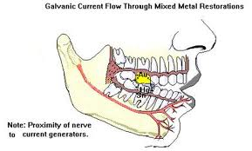

Slide 31
Where is he now?
Lost his license
Has “Huggins Applied Healing” website
Perhaps the biggest problem was that the ADA held the patents for the new high copper amalgam, and could possibly be held liable for 82 quintillion dollars in lawsuits if Huggins was right.

Slide 33
Supposed Effects of Amalgam Toxicity
Huggins found other materials in amalgam toxic: Zinc, Copper, Nickel, and several compounds in composite fillings
Measured electric current in fillings, determined fillings had to be removed in correct order for treatment to be most effective
Found root canals also responsible for various maladies – primary etiologies in sinus inflammation and high blood pressure

Slide 34
Composites

Slide 35
Composites

Slide 36
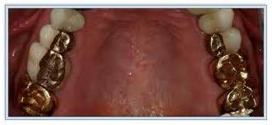
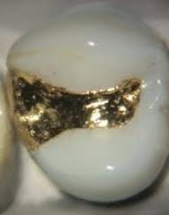
The Gold Standard

