Slide 1
SKEPTICISM & YOUTUBE

Slide 2
Skeptics have established a very strong presence on social networking sites, blogs & podcasts.
But what about YouTube?

Slide 3
Objective
Even when you scroll through the text comments of particularly egregious videos on some of the topics that concern skeptics, informed challenges to the video’s content can be scarce.
I intend to briefly discuss why YouTube is an important battleground in the fight against pseudoscience, particularly for those skeptics who wish to get more involved but haven’t figured out yet how best to help the movement.

Slide 4
Type “vaccines” into YouTube…
If you type “vaccines” into the YouTube search bar, you find an endless supply of videos that essentially tell you that if you vaccinate, you will die.

Slide 5
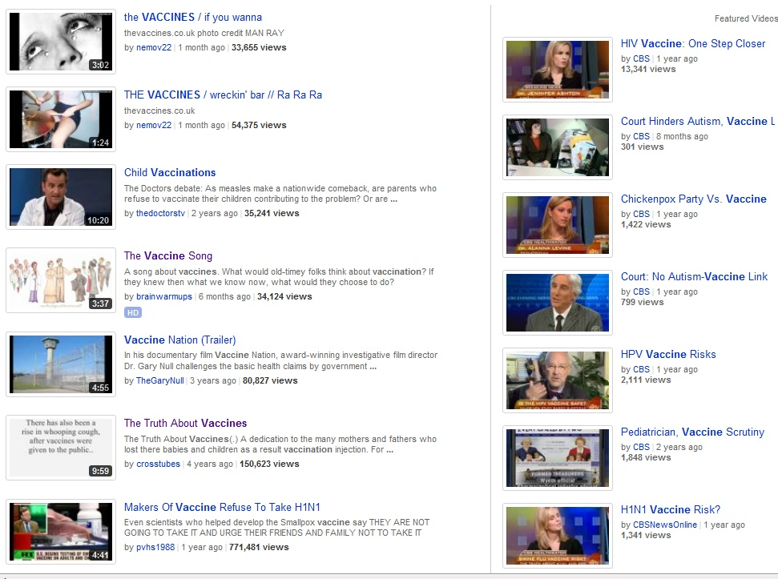

Slide 6
Other search terms
If you type “9/11” into YouTube’s search bar, you’ll find an enormous amount of videos perpetuating the already thoroughly debunked myth that 9/11 was “an inside job.”
If you type in “acupuncture,” you’ll find tons of material about many forms of it like “cat acupuncture” or “acupuncture for athletes” or “crystal acupuncture.”

Slide 7
But you won’t find much content challenging the efficacy of acupuncture.

Slide 8
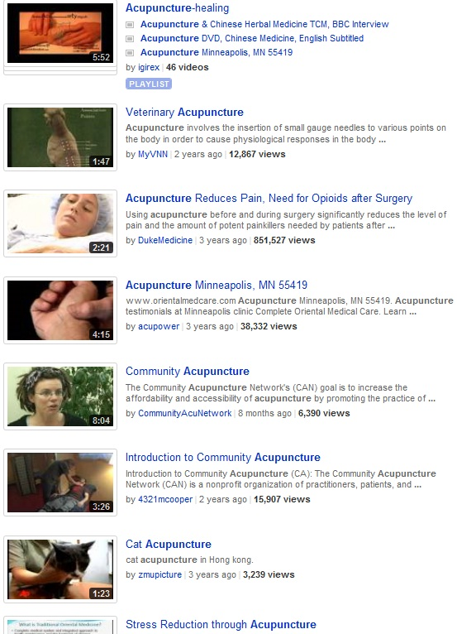

Slide 9
So why is YouTube important?
Last year, Nielsen Online declared YouTube the 5th most popular web brand in the U.S.

Slide 10
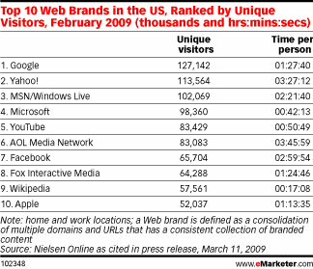
…behind Google, Yahoo!, MSN & Microsoft

Slide 11
Facebook was only ranked #7.
In Feb. 2009, YouTube had over 83 million unique visitors .
The number of monthly visitors on YouTube is almost certainly much higher now.

Slide 12
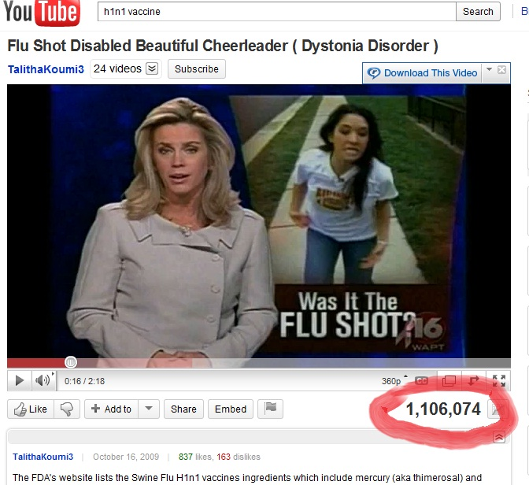
YouTube influence is growing

Slide 13
Is pseudoscience on YouTube being challenged?
I’ve recently heard on more than one skeptical podcast that the hosts and guests “don’t waste their time” trying to educate on YouTube, despite its popularity.
Even when popular skeptical bloggers like Orac draw attention to pseudo-scientific videos & embed them in the blog, few bother to visit the video’s main page to rate it down or leave a comment.

Slide 14
What skeptics can do:
Make videos that promote hard science or critical thinking, or that challenge pseudo-scientic claims.
Make text comments correcting misinformation presented in already existing videos
Help the ranking of quality skeptical videos like those of YouTuber C0nc0dance while rating down the garbage.

Slide 15
Will this change minds?
Sadly, for the true believers, it probably won’t.
However, this can impact casual viewers who are on the fence and who just stumbled onto the video.
Also, in time, through trial & error, you may become better at making your argument.

Slide 16
Warning:
Sometimes, after crafting a beautiful, concise 500 character refutation to someone in a text comment, your hard work will get deleted, so consider copying your best comments and pasting them in a document.
Don’t be surprised if you occasionally get email saying someone replied to a comment you made a year ago.
Ignore “trolls”

Slide 17
In order to be heard…
Skeptics need to go where the people are.
And like it or not, YouTube is where the people are.
If someone is looking up info about vaccines on YouTube & finds almost exclusively misinformation designed to discredit vaccines in the minds of the public, that’s a serious problem.

Slide 18
YouTube is as good a skeptical tool as any other on the internet.

Slide 19
Proposal:
To undo the damage, I propose we attempt to organize a campaign consisting perhaps mostly of skeptics who have the strong desire to participate in skeptical activism but may not know yet how they can best contribute to the cause.
If a 1000 skeptics united to vote up strong skeptical material on YouTube & vote down the garbage, that alone could have a large impact.

